Slide 1

C-Suite Presentation
Ryan Coon
CYB-505
Professor Devin Ogg
August 14, 2024

Slide 2
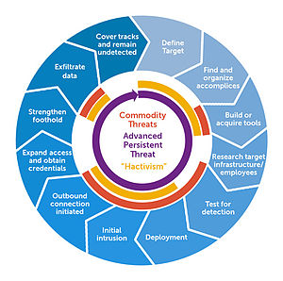
Threat Actors
Advanced Persistent Threat (APT)
An APT refers to a prolonged and targeted cyberattack in which an intruder gains access to a network and remains undetected for an extended period.
Key Characteristics
Advanced:
Utilizes sophisticated techniques and tools to exploit vulnerabilities in security systems. Involves the use of zero-day attacks, malware, and social engineering tactics.
Persistent:
Attackers maintain a long-term presence within the target network to achieve their objectives. Continuous effort is made to evade detection and maintain access.
Threat:
Focuses on high-value targets, such as government agencies, corporations, and critical infrastructure. The goal is often to steal sensitive data, intellectual property, or engage in espionage.
Notes:
Threat actors come in various forms, each with unique motivations and methods. Recognizing these categories is essential for organizations to develop effective cybersecurity strategies. By employing robust security measures, conducting regular training, and fostering a culture of vigilance, organizations can better protect themselves against the multifaceted threats posed by these actors.

Slide 3

Threat Actors
Cyberterrorism
Cyberterrorism refers to the use of the internet and digital technologies to conduct violent acts or threats intended to create fear, cause harm, or disrupt the functioning of a society, organization, or government. This form of terrorism leverages cyber capabilities to achieve political, ideological, or social objectives.
Key Characteristics
Intent:
The primary goal is to instill fear and panic within a population or to coerce governments into specific actions.
Targets:
Critical infrastructure (e.g., power grids, transportation systems, healthcare services).
Government agencies and military networks.
Corporations and financial institutions.
Public institutions and individuals.

Slide 4

Threat Actors
Script Kiddies
Script kiddies are individuals, often inexperienced hackers, who use pre-written scripts or software tools to carry out cyberattacks without a deep understanding of the underlying technology or programming. These individuals typically lack the skills to create their own hacking tools and rely on the work of more skilled hackers.
Key Characteristics
Limited Knowledge:
Script kiddies usually possess minimal technical expertise and rely on existing tools created by others.
Use of Automated Tools:
They utilize readily available software, scripts, and exploits to perform attacks, such as denial-of-service (DoS) attacks, website defacement, or simple hacking.
Motivation:
Motivations can vary from curiosity and thrill-seeking to a desire for notoriety or recognition within certain online communities.
Target Selection:
Script kiddies often target less secure systems, websites, or networks, as they are generally looking for easy targets to exploit.

Slide 5
Threat Actors
Cybercriminals
Cybercriminals are individuals or groups that engage in illegal activities online, often with the intent to steal personal information, financial data, or disrupt services. Their methods can vary widely, but they typically exploit vulnerabilities in technology and human behavior.
Key Characteristics of Cybercriminals
Motivation:
Primarily driven by financial gain but can also include political or ideological motives.
Techniques:
Use various methods such as phishing, malware, ransomware, and identity theft to achieve their goals.
Targets:
Individuals, businesses, and government entities are common targets for cybercriminals.

Slide 6

Threat Actors
Hacktivists
Hacktivists are individuals or groups who use hacking techniques to promote political agendas, social change, or ideological beliefs. Their activities are often characterized by a desire to draw attention to specific issues, challenges, or injustices through cyber means.
Key Characteristics of Hacktivists
Motivation:
Driven by political, social, or environmental causes rather than financial gain.
Ethical Justification:
Often believe that their actions are justified as a form of protest or activism against perceived wrongdoing.
Target Selection:
Typically target government agencies, corporations, or organizations that they view as oppressive or unjust.

Slide 7
Threat Actors
Industrial Espionage
(relating to intellectual property)
Industrial espionage involves the clandestine gathering of confidential information from businesses or organizations, primarily to gain a competitive advantage. This practice often targets intellectual property (IP), which encompasses patents, trade secrets, trademarks, and copyrights.
Key Aspects of Industrial Espionage
Objective:
To obtain sensitive information that can lead to financial gain, improved products, or market advantage.
Targets:
Competitors in the same industry, research institutions, and sometimes government entities.

Slide 8
Threat Actors
Insider Threats
Insider threats refer to security risks that originate from individuals within an organization, such as employees, contractors, or business partners. These individuals have legitimate access to the organization's systems and data, making it challenging to detect potential malicious activities.
Key Characteristics of Insider Threats
Types of Insiders:
Malicious Insiders: Individuals who intentionally cause harm or steal information for personal gain or to damage the organization.
Negligent Insiders: Employees who inadvertently expose the organization to risk through careless behavior or lack of awareness.
Compromised Insiders: Individuals whose accounts or access have been taken over by external attackers.
Motivations:
Financial gain, revenge, corporate espionage, personal grievances, or unintentional mistakes.

Slide 9

Prioritization of Threats
APT Threats
Insider Threats
Cybercriminals
Hacktivists
Industrial Espionage
Cyberterrorism
Script Kiddies
Notes:
Ranking, why, how affected
APT Threats - Is a sophisticated and targeted cyberattack that seeks to infiltrate and remain undetected within a network for the purpose of extracting sensitive information or disrupting operations.
Insider Threats - They have legitimate access to sensitive data and systems, making it easier for them to cause significant damage or steal valuable information.
Cybercriminals - They employ various tactics such as phishing, ransomware, and hacking to exploit vulnerabilities, often targeting organizations for monetary gain.
Hacktivists - While not always financially motivated, their activities can disrupt operations and damage reputations, particularly if they target sensitive data related to their causes.
Industrial Espionage - They may employ tactics like social engineering or hiring insiders to obtain sensitive information, leading to competitive advantages.
Cyberterrorism - They often have significant resources and advanced capabilities, making them dangerous, especially to critical infrastructure and national security.
Script Kiddies - While they can cause disruptions and minor breaches, their lack of sophistication generally limits the severity of the threat they pose.

Slide 10
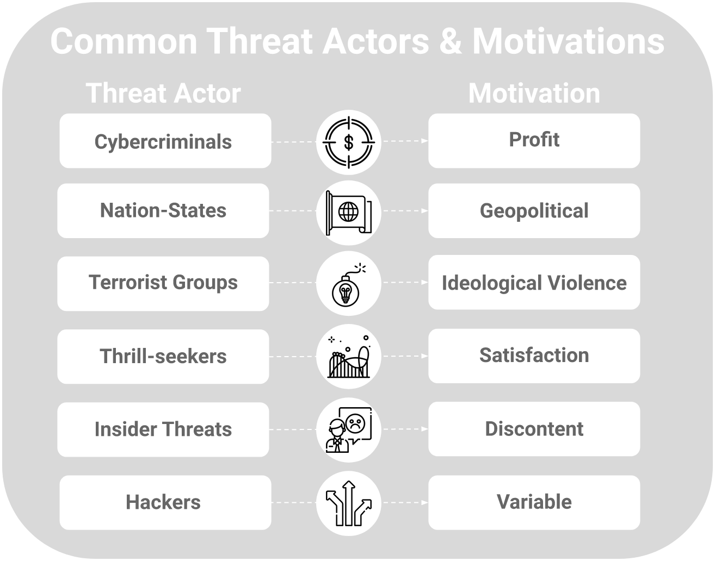
The Adversary
In the context of cybersecurity, an adversary refers to any individual or group that seeks to exploit vulnerabilities in information systems for malicious purposes.
Key Characteristics
Motivation:
Financial Gain: Many adversaries aim to steal sensitive data or disrupt services to extort money (e.g., through ransomware).
Political/Social Causes: Some adversaries, like hacktivists, are driven by ideological beliefs and seek to promote a cause through cyber means.
Competitive Advantage: Competitors may engage in corporate espionage to gain insights into proprietary information.
Revenge/Sabotage: Disgruntled employees or insiders may act out of personal grievances.

Slide 11
The Adversary
Advanced Persistent Threats
Assumption | Long-Term Commitment, Resource Availability, Targeted approach
Goals | Data exfiltration, Espionage, Disruption, Infrastructure Manipulation
Capabilities | Technical Expertise, Resource Access, Stealth and Persistence
Techniques | Spear Phishing, Zero-Day Exploits, Command and Control, Lateral movement
Risk aversion | Utilize specialty software that looks for malware, tracks daily vulnerabilities
Insider Threats
Assumption | Access to Sensitive Information, Potential for Discontent, Unintentional Risks
Goals | Data Theft, Sabotage, Financial Gain
Capabilities | Legitimate Access, Knowledge of Systems, Potential for Coercion
Techniques | Social Engineering, Data Exfiltration, Misuse of Access, Insider Collusion
Risk aversion | Observe odd behavior and or work patterns
Cybercriminals
Assumption | Profit Motive, Anonymity and Impunity, Weak Security Postures
Goals | Financial Gain, Data Theft, Disruption, Reputation Damage
Capabilities | Technical Skills, Resource Access, Networking
Techniques | Phishing Attacks, Ransomware, Exploitation of Vulnerabilities, Social Engineering
Risk aversion | Utilize network encryption and firewalls
Cyberterrorism
Assumption | Impact on Society, Vulnerability of Targets, Global Reach
Goals | Instilling Fear, Disruption of Service, Political Objectives, Recruitment and Propaganda
Capabilities | Technical Expertise, Resource Access, Organizational Structure
Techniques | Denial of Service Attacks, Malware Deployment, Social Media Manipulation, Critical Infrastructure Targeting
Risk aversion | Optimize passwords, Stronger encryption

Slide 12
The Adversary
Hacktivists
Assumption | Moral Justification, Public Support, Target Organizations with weak cyber defenses
Goals | Raising Awareness, Disruption, Information Disclosure, Promoting Change
Capabilities | Strong technical skills with access to a wide variety of hacking tools, Often operate in groups (networking)
Techniques | Website Defacement, Denial of Service Attacks, Data Leaks, Social Media Campaigns
Risk aversion | Utilize stronger passwords and use Multi-Factor Authentication (MFA)
Script Kiddies
Assumption | Ease of Access, Low Risk of Detection, Limited Understanding of Consequences
Goals | Attention and Recognition, Disruption and Chaos, Curiosity
Capabilities | Basic Skills, Access to Hacking Tools, Limited Problem-Solving Ability
Techniques | DDoS Attacks, Website Defacement, Exploiting Vulnerabilities, Social Engineering
Risk aversion | Limit access of hacking tools to the public

Slide 13

Bad Actors
Bad actors in cybersecurity encompass a wide range of individuals and groups, each with distinct motivations, capabilities, and methods. Understanding these categories is crucial for organizations aiming to enhance their cybersecurity posture. By implementing comprehensive security measures, conducting regular training, and fostering a culture of security awareness, organizations can better defend against the diverse threats posed by these bad actors.

Slide 14
References
Brewster, B., Kemp, B., Galehbakhtiari, S., & Akhgar, B. (2015). Cybercrime. Application of Big Data for National Security, 108–127. https://doi.org/10.1016/b978-0-12-801967-2.00008-2
Do, Q., Martini, B., & Choo, K.-K. R. (2019). The role of the adversary model in applied security research. Computers & Security, 81, 156–181. https://doi.org/10.1016/j.cose.2018.12.002
Mandiant. (2023). Advanced Persistent Threats (APTs) | Threat Actors & Groups. Mandiant. https://www.mandiant.com/resources/insights/apt-groups
McMillan, T. (2020). CompTIA Cybersecurity Analyst (CySA+) CS0-002 Cert Guide. Pearson IT Certification.
Putman, Patrick. (2018, December 11). DevOpsDays Washington, DC. United States Cybersecurity Magazine. https://www.uscybersecurity.net/hacktivist/
What is a Bad Actor in Cyber Security? (n.d.). Www.linkedin.com. https://www.linkedin.com/pulse/what-bad-actor-cyber-security-graham-lind
What is a Threat Actor? Types & Examples. (2024, August 8). SentinelOne. https://www.sentinelone.com/cybersecurity-101/threat-intelligence/threat-actor/

